Slide 1
Part 2 of Hotel Booking Cancellation Analysis
Aubrey Kranz, Michael Albers, and Raegan Storin

Slide 2
Content Overview
3 ) Identify Potential Predictor Variables
1 ) Data Collection
2 ) Exploratory Data Analysis and Cleaning
4 ) Additional Preliminary Analysis

Slide 3
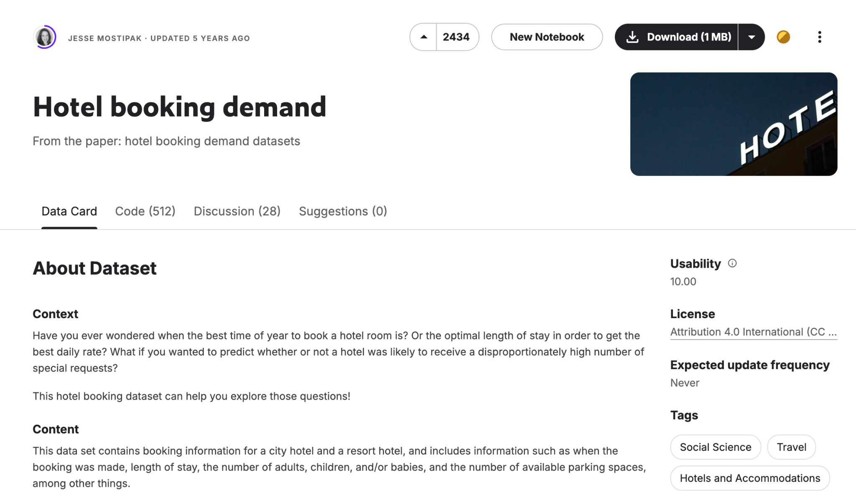
1 ) Data Collection
In the previous step we were already able to find a dataset from Kaggle containing booking information for a city hotel and a resort hotel, including details like booking lead time, cancellation policies, customer types, and various other factors.
We then uploaded and read the data into google ecolab using pd.read_csv(). The original steps in organizing the data, before any major cleaning, included dropping missing values and splitting the information into two separate dataframes for city hotel and resort hotel.

Slide 4
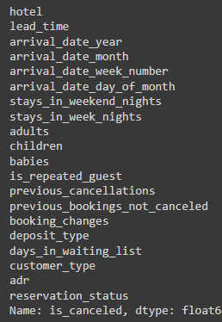
2 ) Exploratory Data Analysis and Data Cleaning
After analysis using df.describe() we were able to better gauge and identify the values within our dataset.
In addition to the missing values removed originally, we simplified the dataset by removing variables unlikely to contribute significantly and converted various categorical variables to numeric.
Ex. (deposit_type: Replaced 'No Deposit', 'Non Refund', and 'Refundable' with 0, 1, and 2)
Notes:
This helps us better prepare for predictive modeling also we can see there is still plenty of variables remaining
Discuss difficulty with date formatting and variable selection

Slide 5
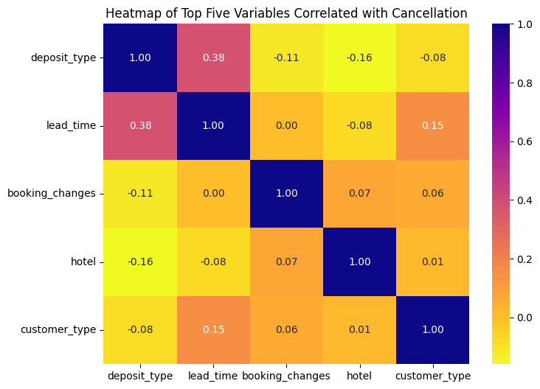
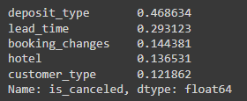
3 ) Identify Potential Predictor Variables
the highest correlation being .38 between deposit and lead time.
We began the process of identifying potential predictor variables by calculating correlation coefficients of each variable.
Deposit Type: Whether the booking required a deposit and what type of deposit was made.
Lead Time: The number of days between the booking and the actual arrival.
Booking Changes: adjustments such as rescheduling a booking
Hotel Type: Whether the booking was made at a city hotel or resort hotel.
Customer Type: Different customer types may have different booking behaviors.

Slide 6
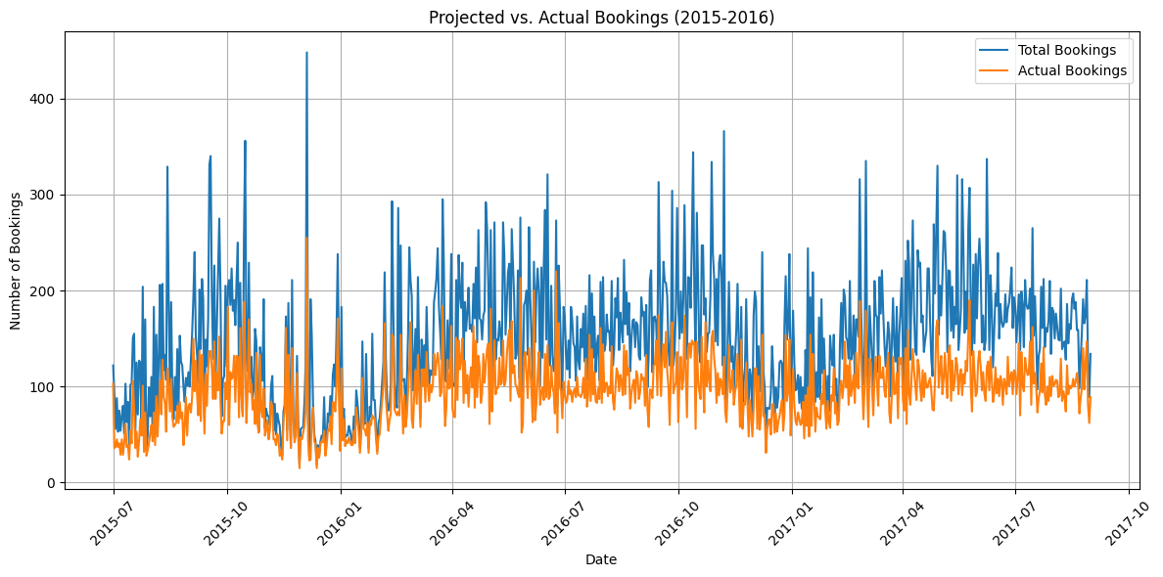
4 ) Additional Preliminary Analysis
While this information is useful, this particular format doesn’t tell us much about how many bookings were canceled beyond “a fair amount”. To improve readability, we next graphed what percentage of each month’s bookings were canceled, rather than individual dates.

Slide 7
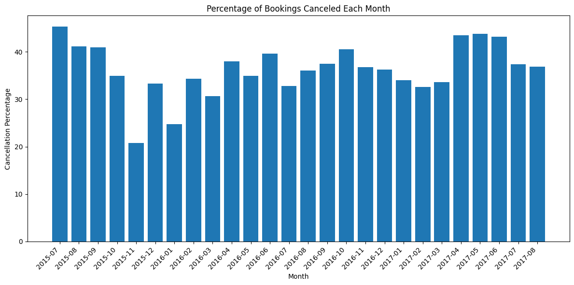
4 ) Additional Preliminary Analysis
This gives us a baseline idea of what we should expect during the modeling phase. A minimum of 20% of bookings were canceled in a given month, a maximum of 45%, and an average of around 35%.

Slide 8
Conclusion
Using the data collected and analysed above we plan to develop a classification and regression predictive model to best determine which reservations will likely be cancelled. We will determine a more specific modeling technique within the next layer of this project in which we will test and develop predictive models.
Our schedule will continue the same as before with a plan to complete all necessary work a week before the due date so that we have plenty of time to discuss what has been done and how to move forward.

Slide 9
Questions?

